Slide 1

Town Hall
Daniel J. Ennis, President
October 24, 2023

Slide 2
updates

Slide 3
Request Updates
Ad Hoc Committee on Budget Sustainability
Has met and been charged
Will coordinate with area VPs to address program level cuts
Recommendations will flow through governance channels up through the Cabinet
University Leadership Council
Has met and been charged
New policy review and development body
Acting Interim Provost
Thank you to Dr. Vicki Bingham!

Slide 4
Remember – 90 Days Cash on Hand
Expense
Amount
Revenue
Years
The number of years of cuts and total amount of cuts
can be reduced with revenue growth

Slide 5
On the Revenue Side…
Centennial Campaign goal doubled to $100 Million
Philanthropy travel across MS and beyond
Alumni chapters reactivated
Conversations with IHL on state support
Local stakeholder meetings
Federal appropriations
Bond bill
Insurance settlements
Auxiliary funds
Space rental
New Sodexo contract terms

Slide 6
What You
Can Do (Part II)
Supporting
Admissions and Enrollment

Slide 7
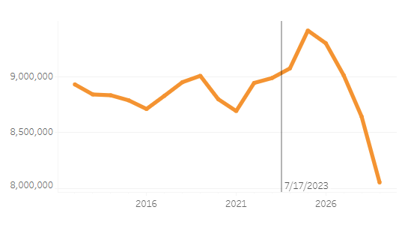
Undergraduate (National Context)
Number of 18 Year Olds (per CUPA-HR)

Slide 8
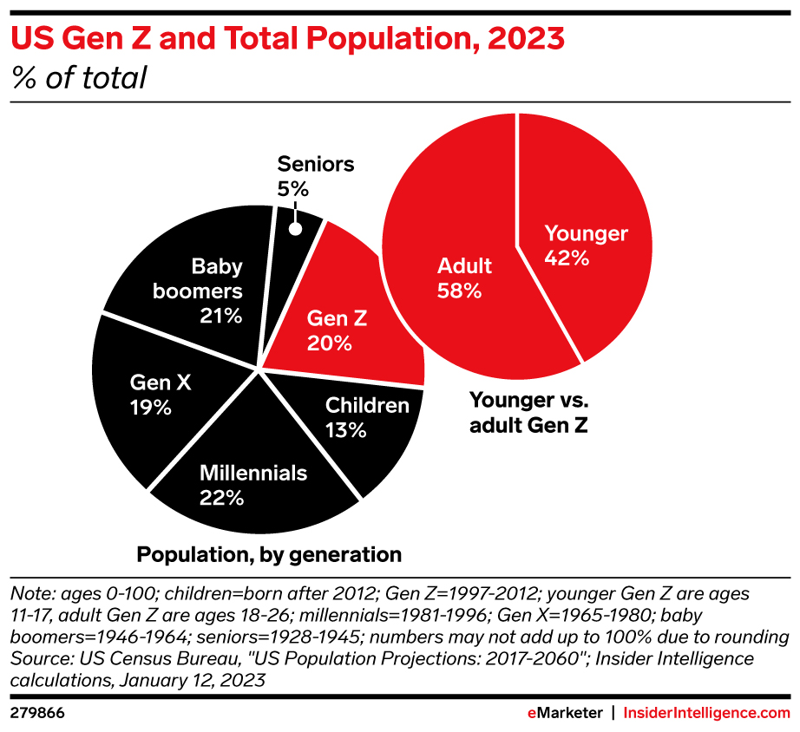
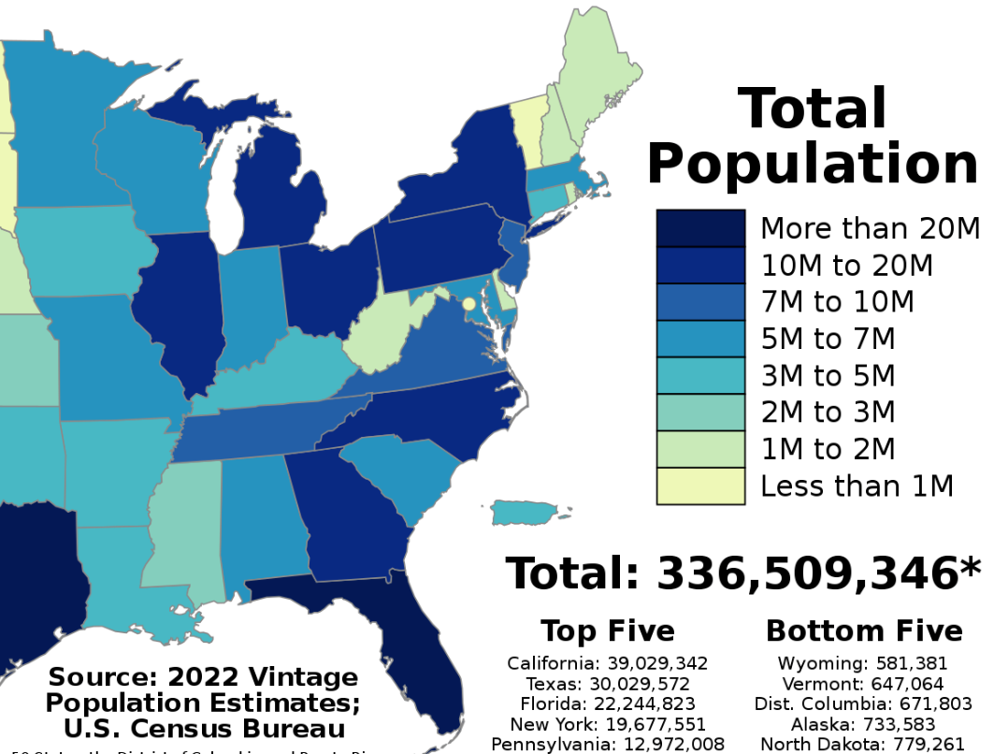
State-by-State

Slide 9
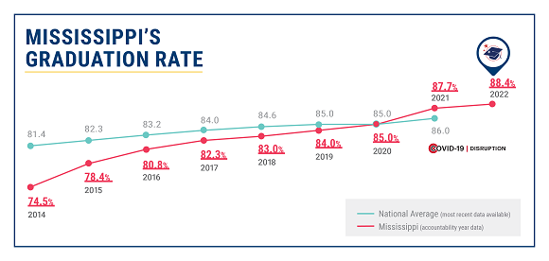
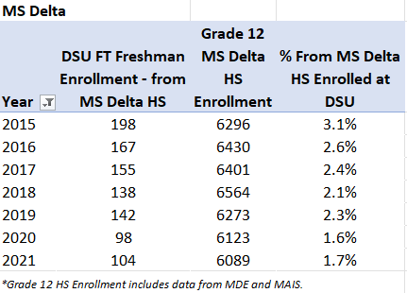
And Yet…

Slide 10
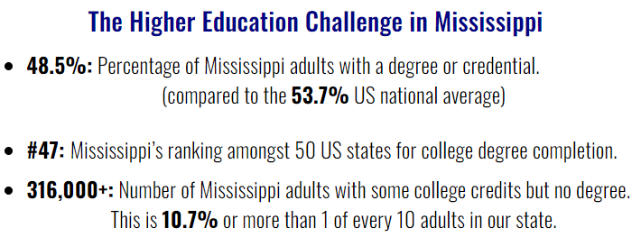
Transfers

Slide 11
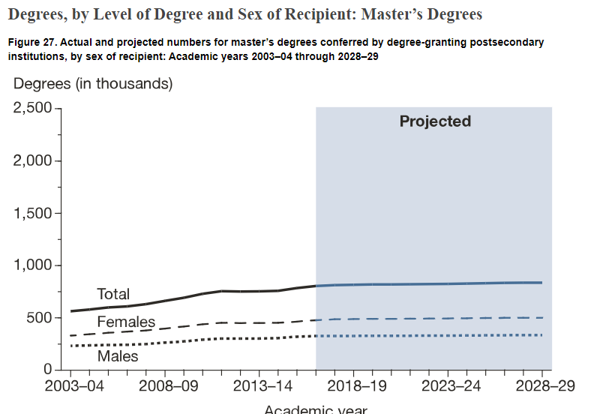
Graduate Recruitment IPEDS Projections
Projected to increase 4% between 2016–17 and 2028–29.

Slide 12
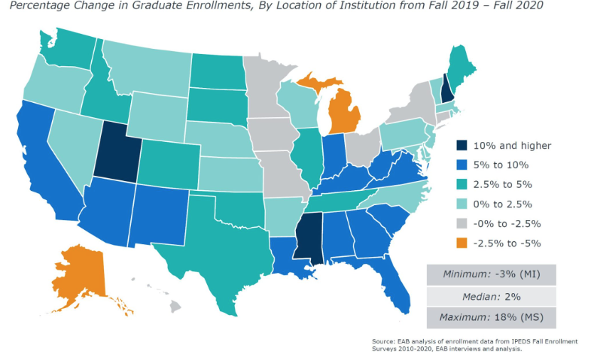
Growth in Mississippi

Slide 13
Action Items

Slide 14
Share Good News
Share exciting things that are happening in your program:
  Office of Undergraduate Admissions
  Communications & Marketing
  Social Media
Promote:
  Accomplishments
  Outstanding internship/employment opportunities
  Awards
  High-profile activities
And like/share/follow if you’re not in that program!

Slide 15
Go Green
Represent Delta State everywhere you go.
  Whether it may be at the grocery store or on a family vacation, wear your green and white
  Act as a brand ambassador for DSU
  Be ready with talking points about our university
  Make a contact, share the contact back to Admissions

Slide 16
Recruiting Events
  Instructors:
  If you have connections at area high schools, work with Admissions to schedule a visit. Time could be split with you sharing information about your discipline and a recruiter sharing what it takes to get admitted at Delta State.
  Let Admissions know what class offerings you have that would be good for a prospective student (or entire classes) to sit in on while on campus.
  Let us know in advance if there are specific days that would be highlights for your program (interesting labs, recitals, etc.)
  Campus community:
  All vice presidents, deans, and chairs have access to the visits calendar
  Engage campus visitors
  Do the little things—tidy up, hold doors, stock takeaway items

Slide 17
Outreach and Communication
Faculty can work with the appropriate dean to email, call, or write to potential students on the merits of an academic program. All deans and their admins have access to the Recruit system and can see a current list of active prospects.
Staff can ensure that the information on departmental and area websites is up-to-date and accurate. This not only helps prospective students/families, but admission staff as well, as this is a primary resource for us to find information quickly, before we call or email. And if your website is up to date, offer to help in another unit!

Slide 18
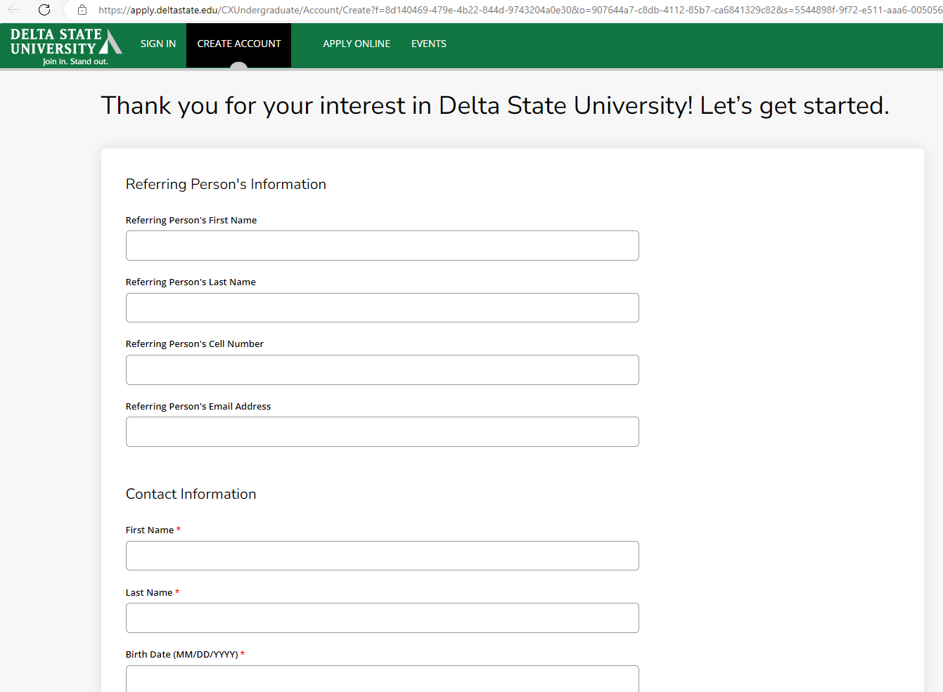
Referrals
www.deltastate.edu/referastudent

Slide 19
Q&A

